Slide 1
WINTERHILL SCHOOL
YEAR 6
PARENT INFORMATION EVENING
Monday 26th June 2023

Slide 2
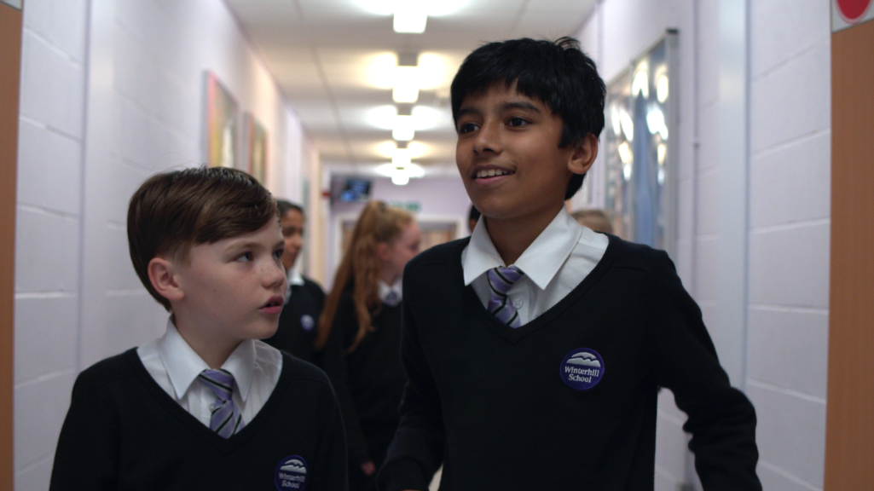
WHAT ARE OUR AIMS FOR EVERY STUDENT?
Every student is happy at Winterhill;
Every student reaches their potential;

Slide 3
BEING WELL PREPARED
Please ensure your child arrives to school punctually, every day, in uniform and with:
writing and drawing equipment;
a school bag;
PE kit on days when they need it;
Please also encourage them to have a good night’s sleep, breakfast and to have water to drink during the day.

Slide 4
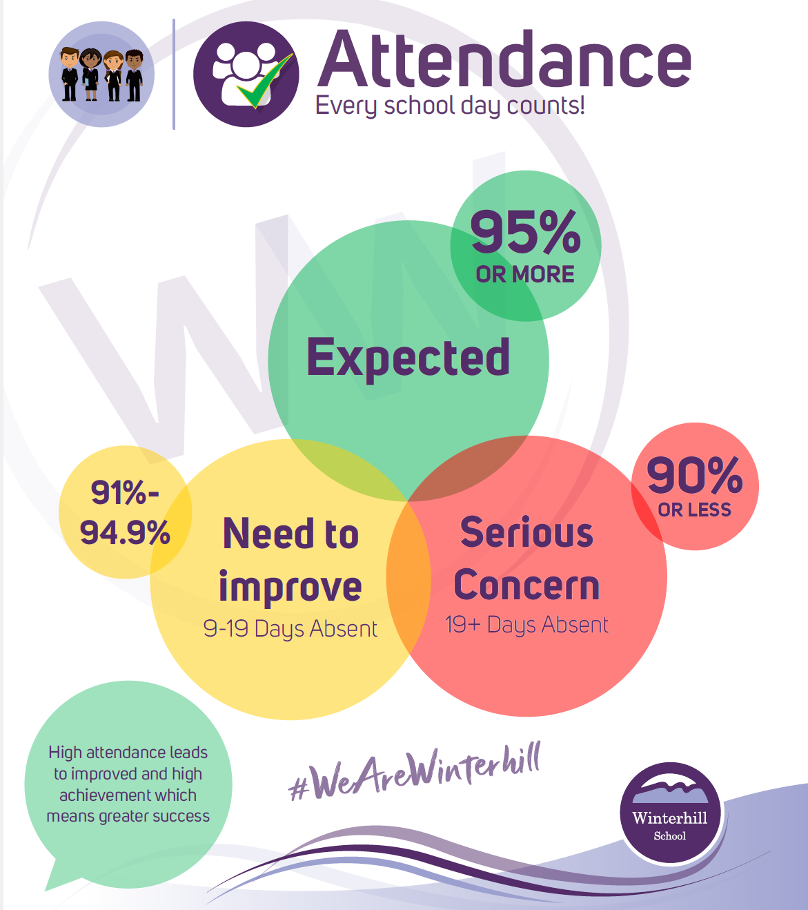
High attendance,
greater chances!

Slide 5
ATTENDANCE AND PUNCTUALITY Supporting your child!
Ensure they leave the house in plenty of time to get to school; school starts at 8.45am
If they are feeling a little unwell – send them in we have a school first aider!
Phone school on the first day of absence;
If a student has not been registered for their morning registration or first lesson parents will receive a message to their mobile stating that they are not in school;
On returning send a note to be given to the Attendance Team/tutor;
Students will not be authorised any holidays in term time, unless there are exceptional circumstances;

Slide 6
Climate for Learning
A Consistent Approach
The Winterhill Way

Slide 7
OUR VALUES
These start with the ‘Student Pledge’

Slide 8
OUR VALUES
3R’s
RESPECT
RESPONSIBILITY
RESILIENCE
BE PROUD TO BELONG TO WINTERHILL

Slide 9
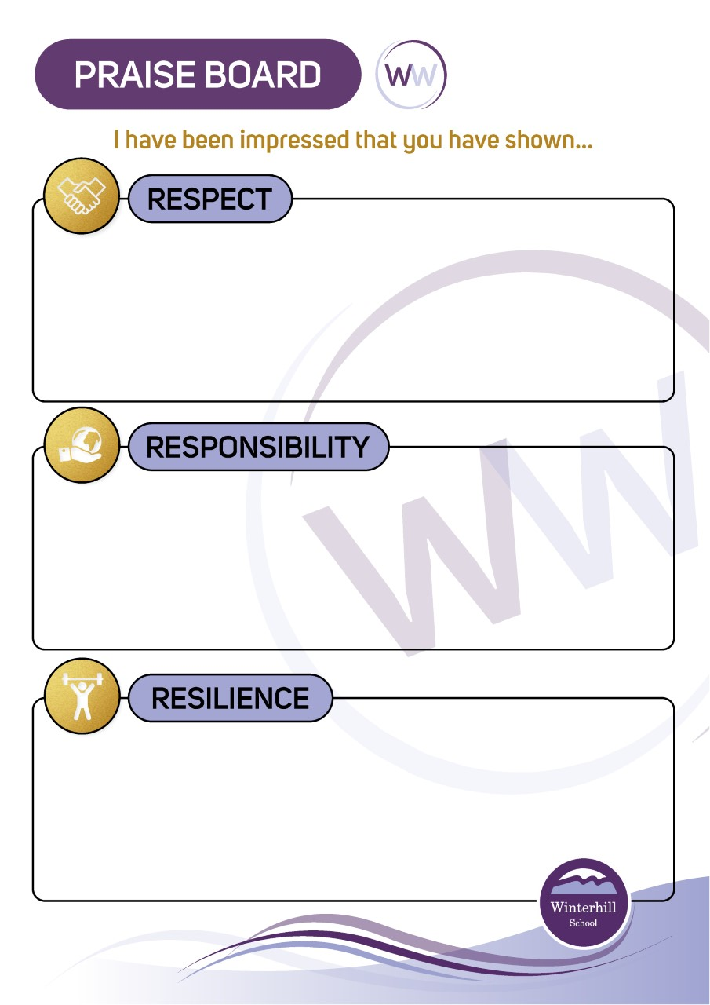
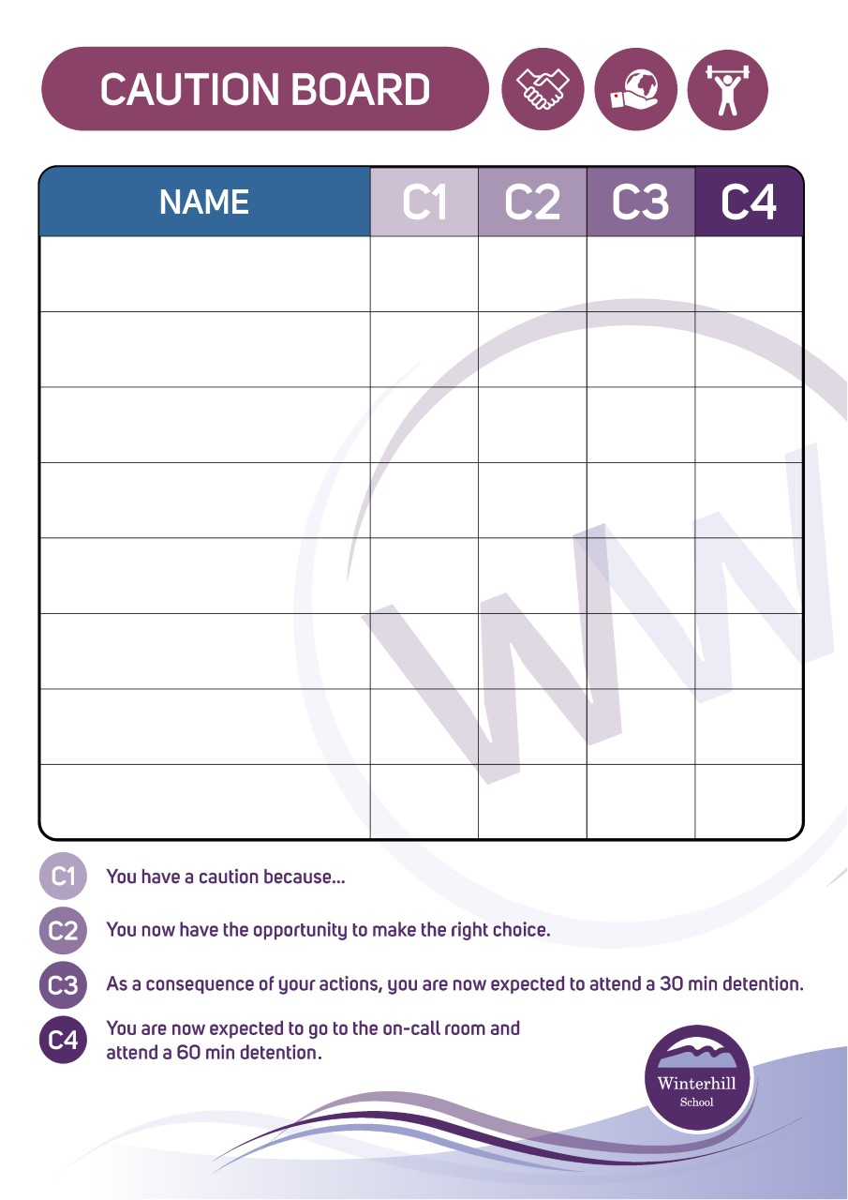

Slide 10
The Reward System

Slide 11
Graduation

Slide 12
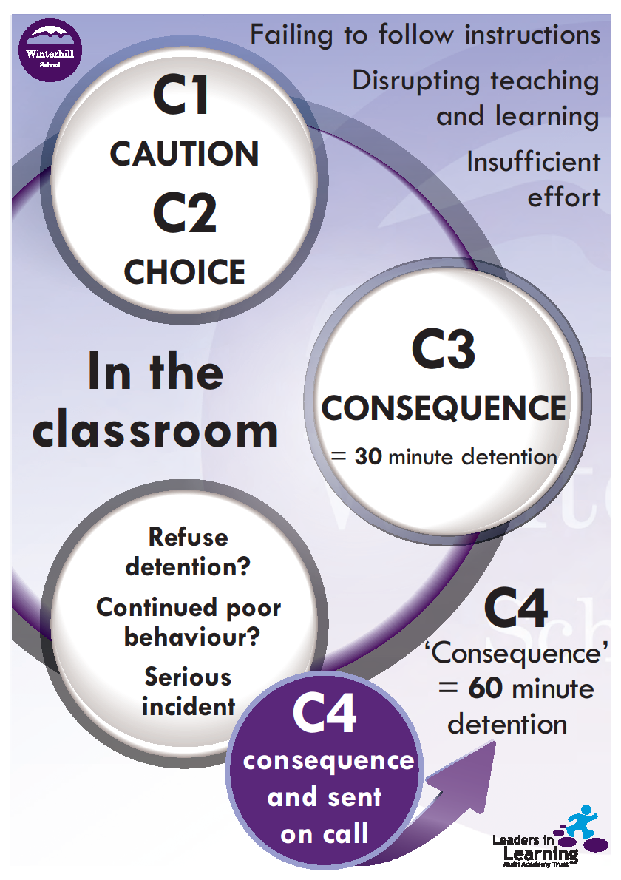
Whole school detentions
Sanctions:
Headteachers detention
Reflection Room

Slide 13
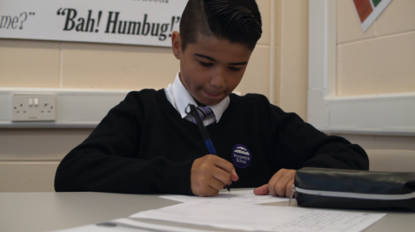
HOW CAN YOU SUPPORT YOUR CHILD ?
Take an interest in their work;
Ensure they are well equipped for the school day;
Ensure they are punctual and have good attendance;
Support them on Parent Evenings and school events;
Getting involved in school – Parent Forums, Friends of Winterhill;
Sign in to google classroom to follow their progress;

Slide 14
The school day - commencing September
 | Y7/8 |  |  |  | Y9/10/11
 | START | FINISH |  |  | START | FINISH
Form | 8.45am | 9.10am |  | Form | 8.45am | 9.10am
1 | 9.10am | 10.25am |  | 1 | 9.10am | 10.25am
BREAK | 10.25am | 10.40am |  | 2 | 10.25am | 11.40am
2 | 10.40am | 11.55am |  | BREAK | 11.40am | 11.55am
LUNCH | 11.55am | 12.30pm |  | 3 | 11.55am | 1.10pm
3 | 12.30pm | 1.45pm |  | LUNCH | 1.10pm | 1.45pm
4 | 1.45pm | 3.00pm |  | 4 | 1.45pm | 3.00pm

Slide 15
A good start to the day!
Year Group | Monday | Tuesday | Wednesday | Thursday | Friday
7 | Introducing the week: Winterhill expectations (Using the league table and the newsletter) | ‘Read to learn’ Literacy activities | Tutor choice e.g. Quiz (Google Forms) | Hub Session (Following on from the assembly the week before) | Assembly
Hub sessions
Let’s discuss!

Slide 16
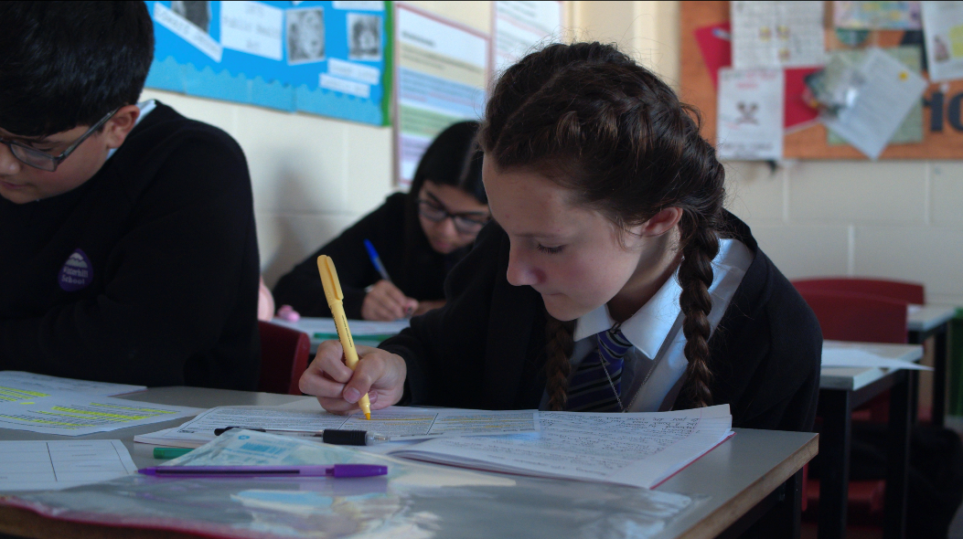
Curriculum
Broad, balanced and inclusive.
All students will experience a full curriculum: Maths, English, English Literature, Science (Physics, Chemistry & Biology), History, Geography, IT, Technology, Food, Art, Drama, Music, RS, French/Spanish, PE, and PSHCE
How are students grouped?
Students will be together during Tutor Time, but will be in different groups for different subjects.
These groups will be re-made in September.

Slide 17
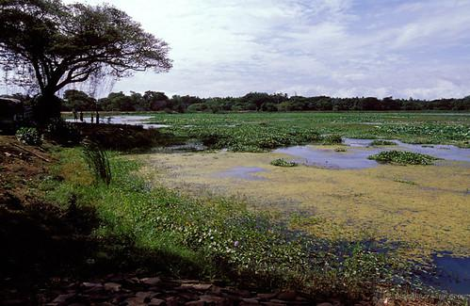
Enrichment
A wide variety of activities which are based on sport, leisure, academic interests and hobbies.

Slide 18
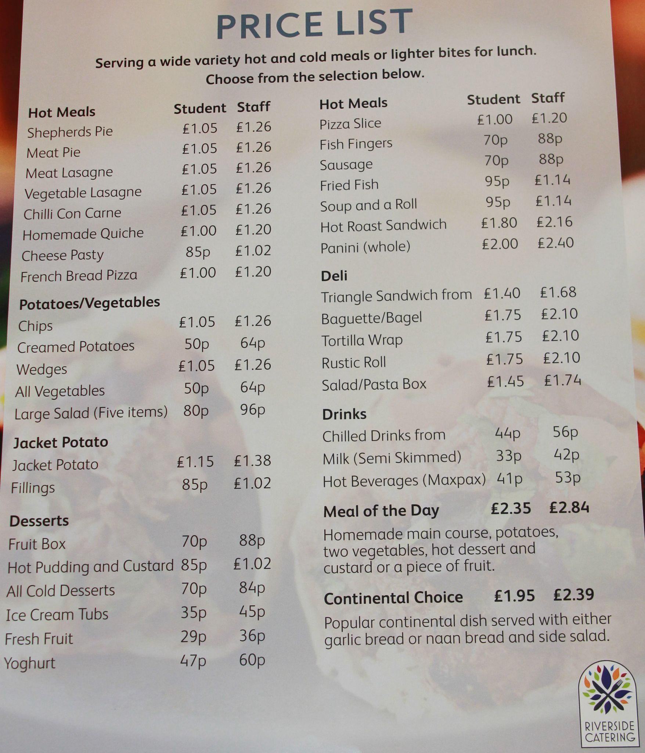
Food @ Winterhill
For the period of the Transition in July, can you bring a snack for morning break time. Morning break starts at 11.40am.
For lunch time you can bring a packed lunch, or you can buy food from the Hall.

Slide 19
Uniform
Transition Uniform (July 2023)
The uniform for the July Transition is to be one of the following choices:
Full Winterhill Uniform,
Current Y6 Uniform,
Any appropriate clothing for a school environment,
The decision of which uniform is to be worn by a child is entirely down to parental choice
The following slides show the uniform that all students must wear from September 2023

Slide 20
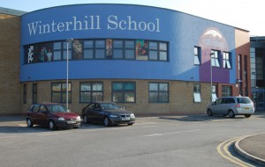
School Day for July
From Monday 11th July to the End of Term
Students can arrive from 8.30am. They will be escorted into school by Prefects/Staff.
The tutor time starts at 8.45am.
Students will be escorted to the main gate by the classroom teacher for 2.55pm.

Slide 21
School Jumper/Cardigan
White Shirt
Black Trousers & Skirt
School Tie

Slide 23
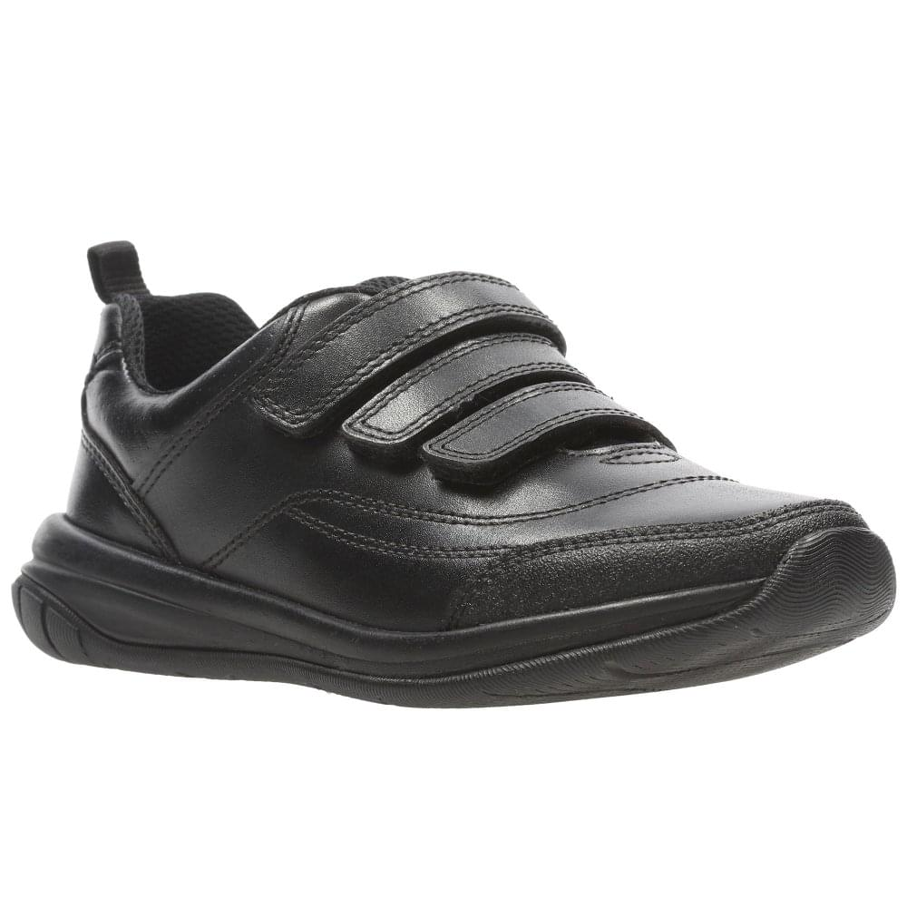
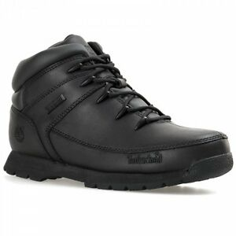
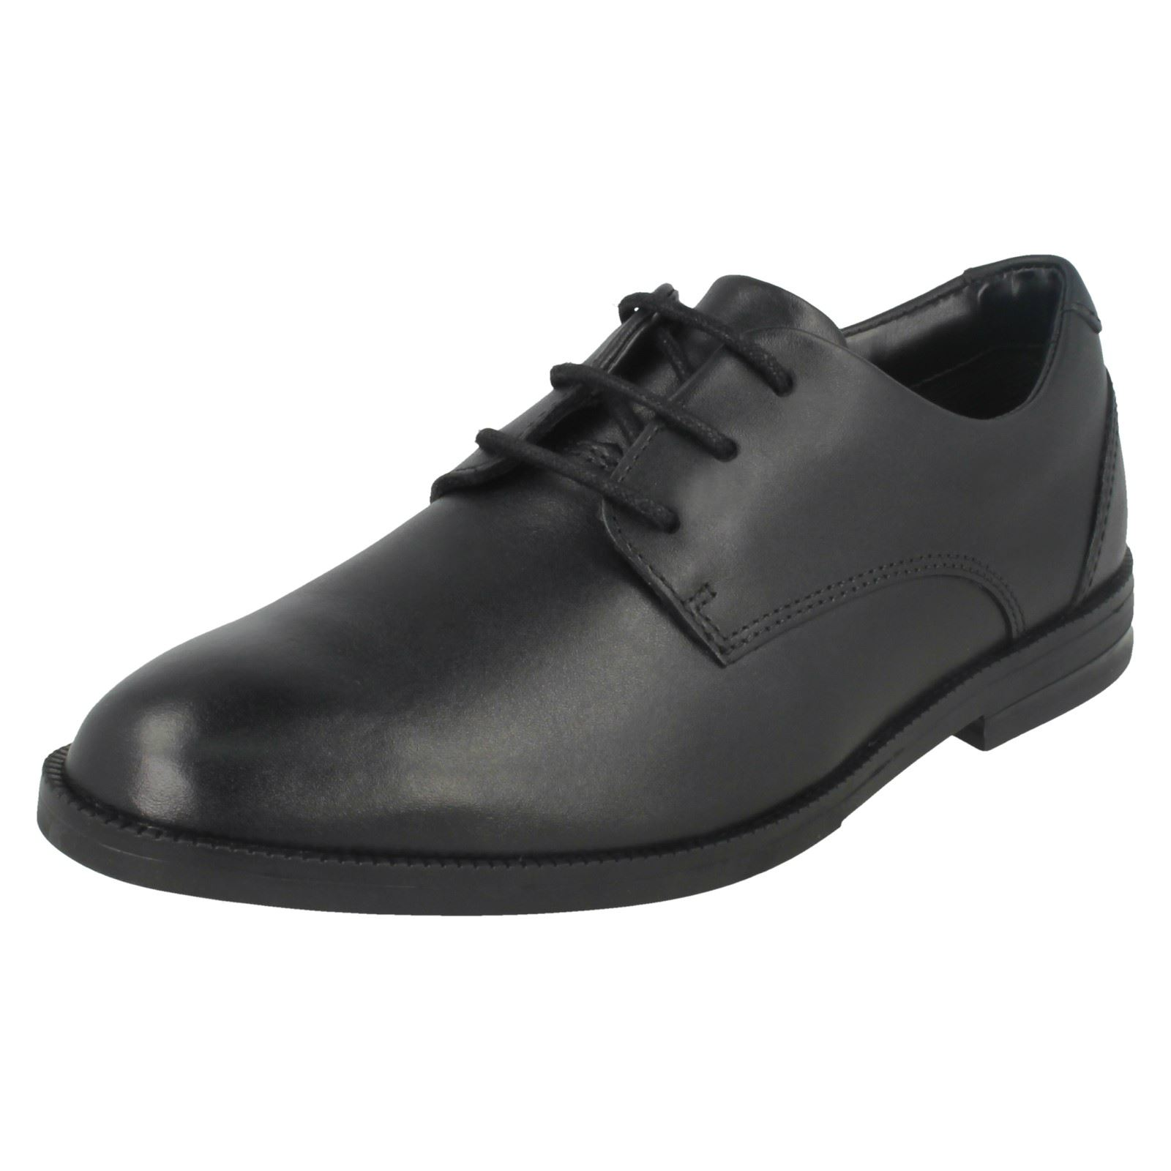
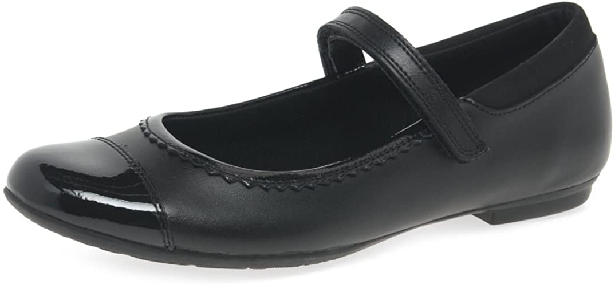
Examples of plain black footwear that are allowed

Slide 25
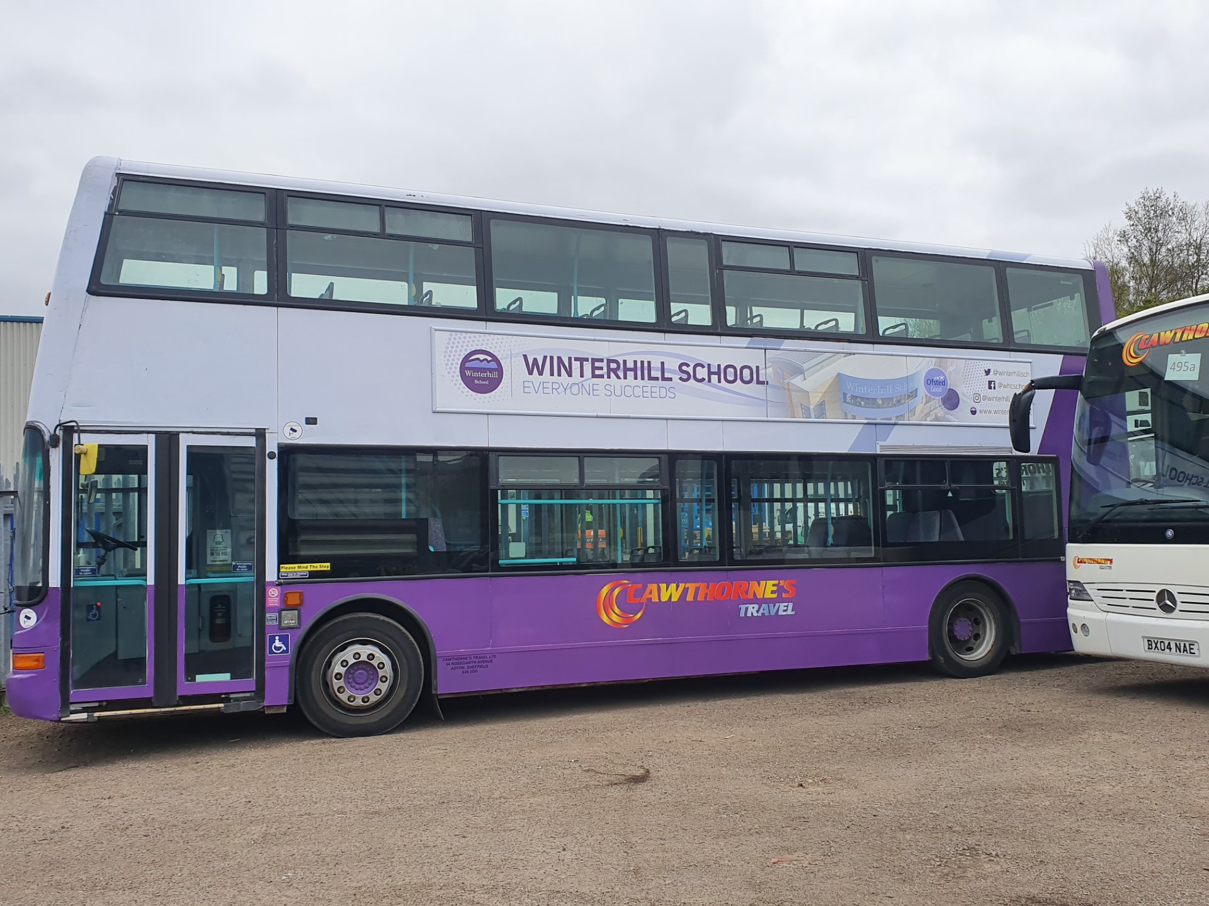
Bus Route
https://www.winterhill.org.uk/busroute
Main Bus route is as follows:
Wincobank, Shiregreen, Ecclesfield, Chapletown, Thorpe Hesley, Scholes, Kimberworth
Details of the timings and exact route can be viewed via the school website.
Payment is either cash (80p per trip/£1.60 per day), or via https://www.cawthornestravel.com/school-bus
Y6 students in July travel free of charge. Any further questions see Dr Reeder

Slide 26
Summer School - July 2023!
Monday 24th July - Friday 28th July
Each day starts at 10.00am, and finish around 2.00pm-3.30pm
Activities include: Art, Music, Food, Technology, Creative Writing, Science, day trips to Castleton Caves and Doncaster Wild Life Park.
All activities are free of charge, and all you have to do is provide a pack lunch!
If you are interested see your Group Tutor, Dr Reeder or email summerschool@winterhill.org.uk

Slide 27
KEY STAFF
Headteacher Mr Rhodes
Deputy Headteacher (Pastoral) Dr Reeder
Deputy Headteacher (Quality of Education) Ms Carnegie
Senior BfLL Mr Jeffery
BfLL Year 7&8 Mrs Annerson
SEND Coordinator Mrs Jenkinson
GROUP TUTOR

Slide 28
CONTACT WITH SCHOOL
Telephone;
Email;
Group Tutor;
Behaviour For Learning Leader;
Contact details are essential and MUST be regularly updated, especially in the case of emergencies;
School website
FB Page

Slide 29
Thank you

