Slide 2
Who are we
We offer the
following school
based immunisations for pupils in both primary and secondary schools:
The immunisation
team is
made up of the following:
FLU
Diphtheria, Tetanus and Polio
Meningitis ACWY
Human Papilloma Virus
Measles, Mumps and Rubella
IMMUNISATION
NURSES
HEALTH CARE
ASSISTANTS
ADMINISTRATION
TEAM
www.intrahealth.co.uk

Slide 3
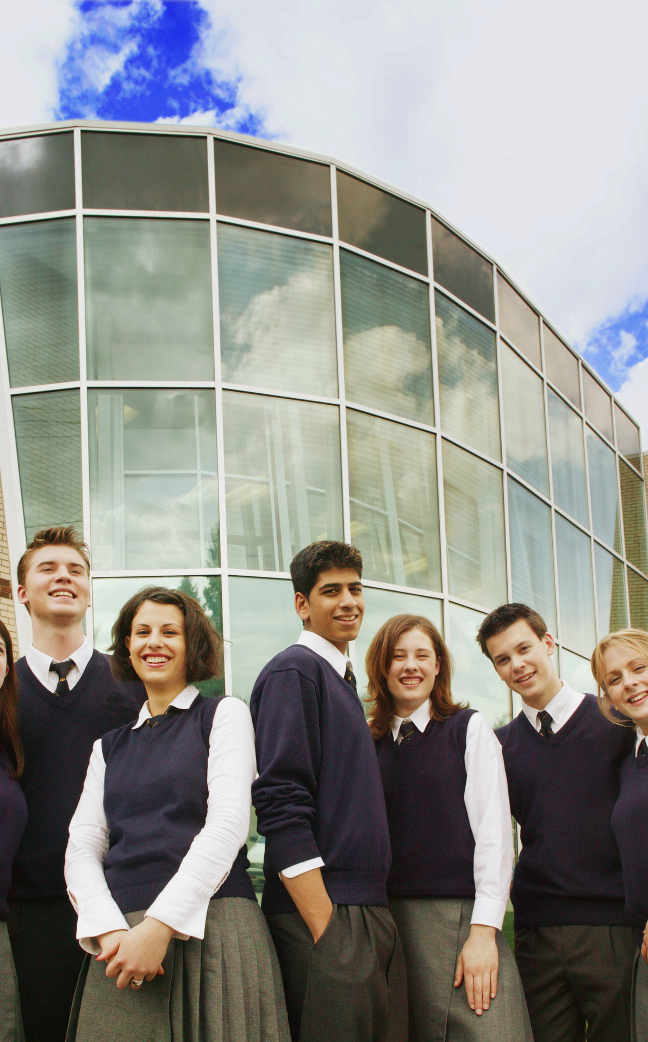
IntraHealth
Human Papilloma Virus
Vaccine (HPV)
www.intrahealth.co.uk

Slide 4
HPV
The HPV (Human papillomavirus) vaccination is offered to girls and boys aged 12 to 13 years in Year 8.
Anyone who misses their HPV vaccination in Year 8 can continue to have the vaccine up to their 25th birthday.
www.intrahealth.co.uk

Slide 5
HPV is the name given to a common group of viruses
Some types of HPV are 'high risk' and can lead to the development of cancers, such as cervical cancers, anal cancers, genital cancers and cancers of the head and neck.
What
is HPV?
Other types of HPV can cause warts or verrucas
Over 99% of cervical cancers are caused by 'high risk' HPV
HPV infections do not normally cause any symptoms and most people will not know they are infected
HPV is very common and can be caught through any kind of sexual contact with someone who already has it. It can be spread through any kind of skin-to-skin contact including touching. It is usually found on the fingers, hands, mouth and genitals
Most people will get a HPV infection at some point and will get rid of it naturally but if you become infected with a 'high risk' HPV infection you will not be able to clear it
www.intrahealth.co.uk

Slide 6
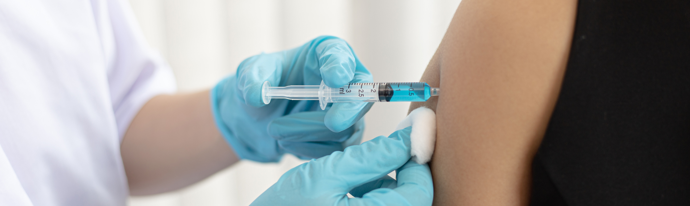
The HPV vaccine
The vaccine currently used to protect against HPV is called Gardasil 9
Gardasil protects against 9 types of HPV (6, 11, 16, 18, 31, 33, 45, 52, and 58)
Types 16 and 18 are the cause of over 70% of most cervical cancers
The vaccination works best if given before you become sexually active which is why the vaccine is given to
12-13 year olds
HPV does not protect against other sexually transmitted diseases and does not stop girls from getting pregnant therefore it is really important to practice safe sex
Remember we are here to support you and getting vaccinated could save your life
www.intrahealth.co.uk

Slide 7
Since the introduction of the girls programme the incidence of genital warts in England has fallen dramatically in both girls and boys.
There has also been a reduction of cases in the different types of HPV that the vaccine helps to protect against.
This suggests that boys are already benefitting from indirect protection and by extending the programme to include boys this will help to prevent more cases of HPV related cancers such as head, neck and genital.
www.intrahealth.co.uk

Slide 8
IntraHealth
Measles, Mumps and Rubella (MMR)
Vaccine
www.intrahealth.co.uk

Slide 9
MMR
MMR is a vaccine that protects against Measles, Mumps and Rubella viruses .
These are highly infectious viral illnesses spread by coughs and sneezes.
It should be given at the age of 12 months and then again before children start school.
We know that some children and young people have missed either 1 or both doses of MMR and so run catch up programmes currently for those in year 8 and above
www.intrahealth.co.uk

Slide 10
What
is
Measles?
Measles is an infection that spreads very easily and can cause serious problems in some people.
Such as pneumonia, meningitis, blindness and seizures (fits)
Most Contagious Virus in the world

Slide 11
Mumps is a contagious viral infection that used to be common in children
What
is
Mumps?
But mumps can lead to viral meningitis if the virus moves into the outer layer of the brain.
Other complications include swelling of the testicles or ovaries (if the affected person has gone through puberty)
Mumps is spread in the same way as colds and flu:

Slide 12
What
is
Rubella?
Rubella is sometimes known as German Measles
it is a rare usually mild illness that
causes a spotty rash.
However if developed in pregnancy it can be serious for the unborn baby.

Slide 13
What to expect on the day of vaccination
All of our nurses have many years of experience
immunising young people
The vaccination is nothing to worry about. The team will talk to you and explain exactly what is going to happen and answer any questions you may have. You will be sat down to receive the vaccine and if you require, we have private/secluded areas where you can go.
If you are worried/apprehensive, we have people who can sit with you whilst you have the vaccination. We do not encourage friends/other pupils to sit with each other as this can lead to overcrowding in the vaccination area.
We fully understand that some people don't like needles etc. All our staff are very supportive and caring - Do not listen to tales from others who say things like: "the needle is massive", "it really hurts", "people keep fainting".
www.intrahealth.co.uk

Slide 14
This is the truth
The needle used is the same size used on a baby and not all of the needle goes into your arm
The more relaxed you are, the less anxious you feel and the sooner the vaccination will be over
It is more uncomfortable than painful and only lasts a few seconds
You will feel a sharp scratch, a little bit like if you catch yourself with your nail, you may also feel a cool sensation and feel a little pressure like someone pressing on your arm as the vaccine goes in.
Some people may feel lightheaded or possibly faint - this is usually down to the fact that they have not eaten that morning and not a reaction to the vaccine - make sure you eat breakfast
Remember we are here to support you and getting vaccinated
could save your life
www.intrahealth.co.uk

Slide 15
FEEDBACK
"Thank you so much for your visit. The nurses that came were extremely patient and we couldn’t fault the service we received"
"Everything was done very efficiently, and the nurses were great with the students - especially those who were a little worried"
"Thank you for all your support and organisation for the vaccinations. It went very smoothly and the team onsite were excellent – very organised and flexible"
"It went really well. Your team were very pleasant and efficient"
"The staff that came into school yesterday to administer the vaccinations were very helpful, friendly and professional. We had a very positive experience"
"Your team did great.
Uptake was better than previous years.
The team were all a pleasure to work with"
www.intrahealth.co.uk

Slide 16
Gillick Competent
Information and consent forms for vaccinations will be sent out to parents and carers prior to the planned vaccination session in school.
This may consist of a paper consent form or link to an electronic consent form for parents or carers to return.
Any child under the age of 16 years old can self-consent for vaccination if assessed as competent by a qualified nurse. This is known as Gillick Competent.

Slide 17
Contact us
EMAIL
contactimms@intrahealth.co.uk
CONTACT NO.
03333 583 397
WEBSITE
www.intrahealth.co.uk

