Slide 2
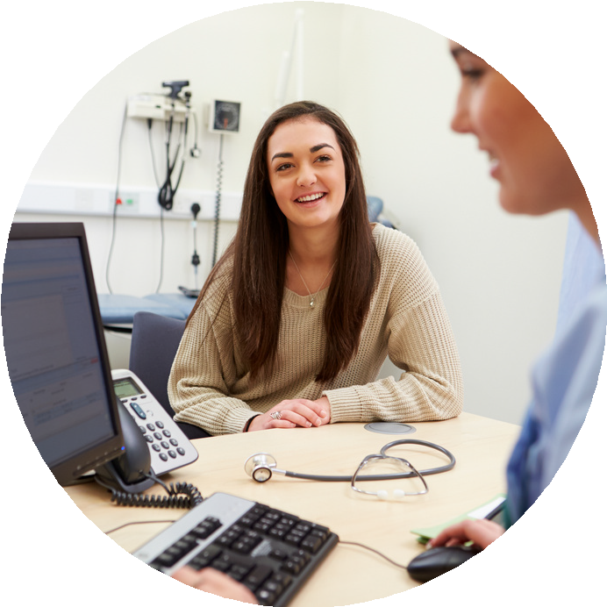
Who are we
The immunisation team is
made up of the following:
We offer the following school
based immunisations for pupils in both primary and secondary schools:
FLU
IMMUNISATION NURSES
Diphtheria, tetanus and polio
HEALTH CARE ASSISTANTS
Meningitis ACWY
Human Papilloma Virus
ADMINISTRATION
TEAM
MMR
www.intrahealth.co.uk

Slide 3
Diphtheria, Tetanus and Polio Vaccine
(Td/IPV)
www.intrahealth.co.uk

Slide 4
During Year 9 you will be invited to receive the Diphtheria, Tetanus and Polio (Td/IPV) vaccine
- Diphtheria Tetanus and Polio - 3 in 1 vaccine
This is a booster following the vaccine that most of you will
have had as a baby, this booster will give you long term
protection against the 3 diseases,
Diphtheria, Tetanus and Polio
www.intrahealth.co.uk

Slide 5
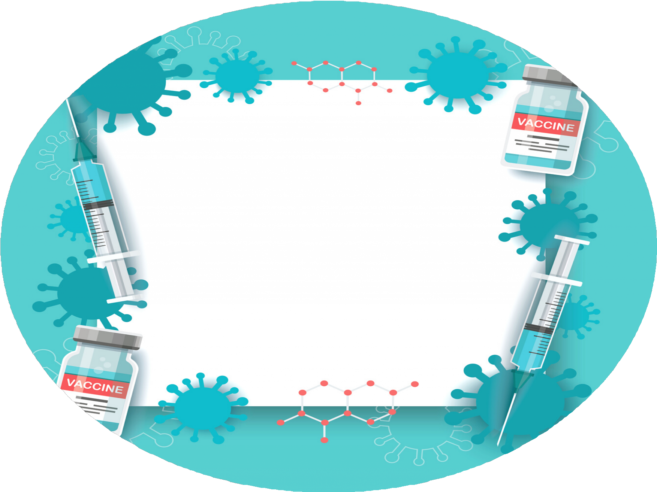
Diphtheria is a serious disease
that usually begins with a sore throat and can quickly cause breathing problems. It can damage the heart and nervous system and in severe cases, can kill.
D I P H T H E R I A G E R M S A R E
S P R E A D F R O M P E R S O N
T O P E R S O N T H R O U G H C L O S E C O N T A C T
What
is Diphtheria?
www.intrahealth.co.uk

Slide 6
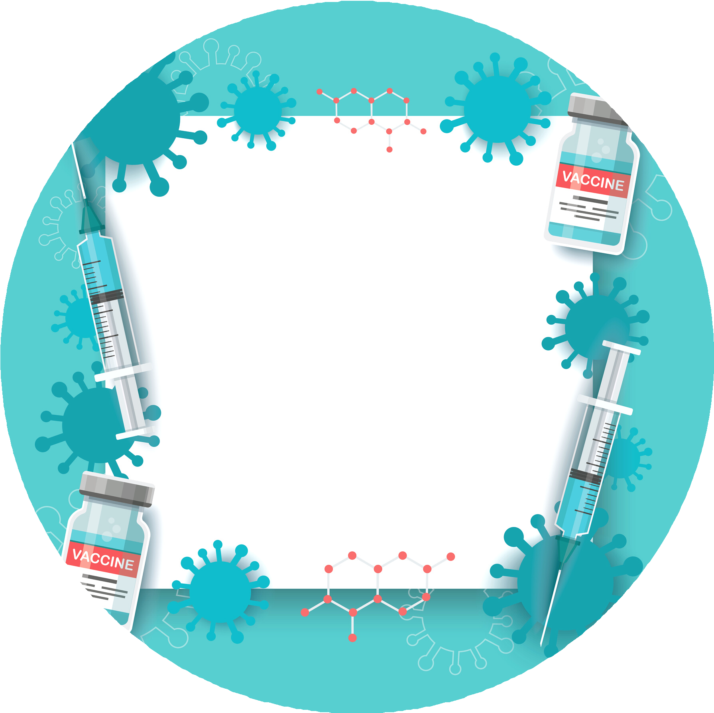
Polio, or poliomyelitis, is a disabling and
life-threatening disease caused by the poliovirus
that can infect a person's spinal cord, causing paralysis (can't move parts of the body).
What is Polio?
What
is Polio?
P O L I O V I R U S C A N B E
P A S S E D
F R O M
P E R S O N
T O
P E R S O N .
www.intrahealth.co.uk

Slide 7
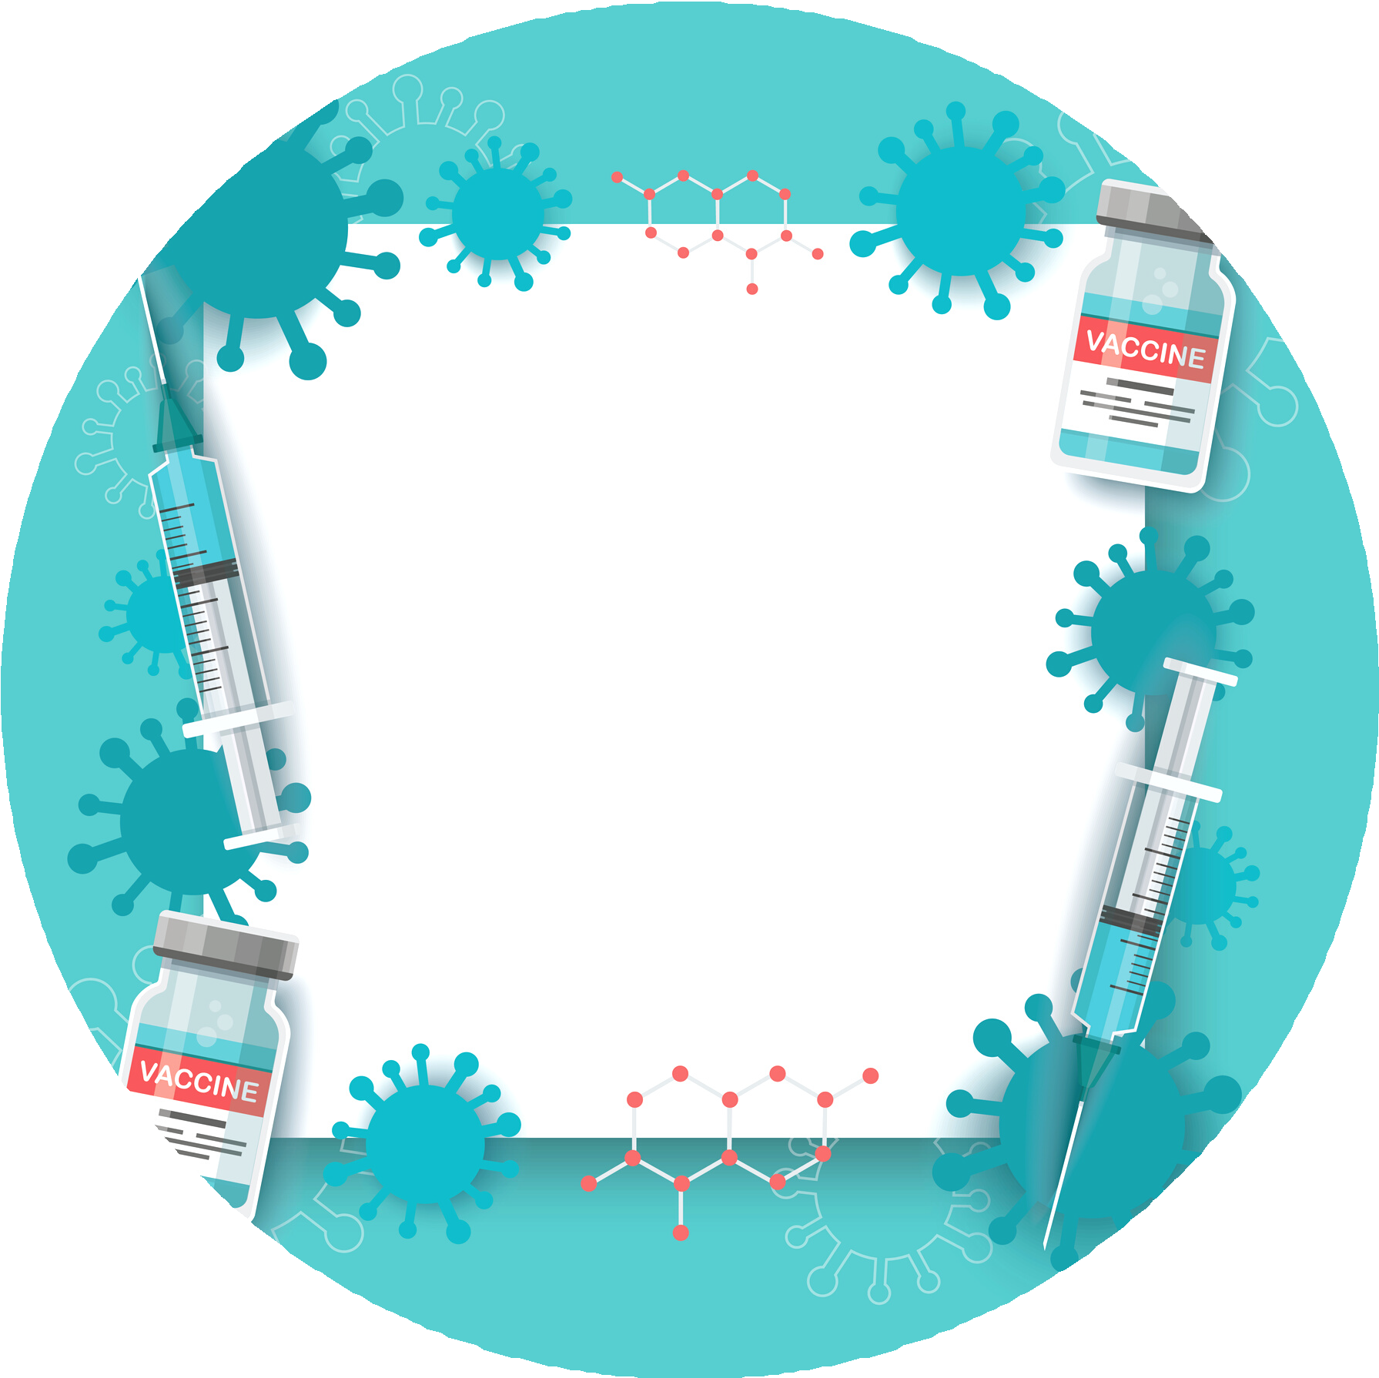
Tetanus is a disease affecting the nervous system
that can lead to muscle spasms, cause breathing problems and even kill. It's caused when germs found in soil and manure get into the body through open cuts or burns.
What
is Tetanus?
T E T A N U S C A N ' T B E
P A S S E D
F R O M
P E R S O N
T O
P E R S O N .
www.intrahealth.co.uk

Slide 8
IntraHealth MeningitisACWY (MenACWY)
Vaccine
www.intrahealth.co.uk

Slide 9
The Meningitis ACWY vaccine is routinely offered to
teenagers in school Years 9 or 10.
www.intrahealth.co.uk

Slide 10
Meningococcal disease (meningitis and septicaemia) is a rare but life-threatening disease caused by meningococcal bacteria.
What
is MenACWY?
that can start like a bad case of flu but then get worse very quickly. A rash can develop, along with a stiff neck.
Early treatment can be lifesaving.
T H E B A C T E R I A A R E S P R E A D F R O M
P E R S O N T O P E R S O N B Y P R O L O N G E D
C L O S E C O N T A C T – S U C H A S C O U G H I N G , K I S S I N G O R S N E E Z I N G – W I T H S O M E O N E W H O I S C A R R Y I N G T H E B A C T E R I A .
www.intrahealth.co.uk

Slide 11
Why teenagers and students should have the MenACWY vaccine
Meningococcal disease (meningitis and septicaemia) is a rare but life-threatening disease caused by meningococcal bacteria.
Older teenagers and new university students are at higher risk of infection because many of them mix closely with lots of new people, some of whom may unknowingly carry the meningococcal bacteria at the back of their nose and throat.
Anyone who is eligible for the MenACWY vaccine should have it, even if they have previously had the MenC vaccine.
The MenACWY vaccine is highly effective in preventing illness caused by the 4 meningococcal strains, including the extremely harmful MenW strain.
www.intrahealth.co.uk

Slide 12
The dangers of meningococcal disease
Meningococcal disease can cause both meningitis and septicaemia (blood poisoning). Septicaemia and meningitis can trigger sepsis, which is a life-threatening response to infection.
Meningococcal disease is rare but very serious. It requires urgent hospital treatment.
It can lead to life-changing disabilities, such as amputations, hearing loss and brain damage.
www.intrahealth.co.uk

Slide 13
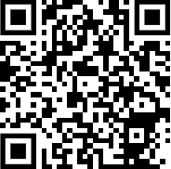
Measles, Mumps and Rubella (MMR)
Vaccine
www.intrahealth.co.uk

Slide 14
MMR
MMR is a vaccine that protects against Measles, Mumps and Rubella viruses .
These are highly infectious viral illnesses spread by coughs and sneezes.
It should be given at the age of 12 months and then again before children start school.
We know that some children and young people have missed either 1 or both doses of MMR and so run catch up programmes currently for
those in year 8 and above
www.intrahealth.co.uk

Slide 15
What
is Measles?
Measles is an infection that spreads very easily and can cause serious problems in some people.
Such as pneumonia, meningitis, blindness and seizures (fits)
Most Contagious Virus in the world

Slide 16
What
is Mumps?
Mumps is a contagious viral infection that used to be common in children
But mumps can lead to viral meningitis if the virus moves into the outer layer of the brain.
Other complications include swelling of the testicles or ovaries (if the affected person has gone through puberty)
Mumps is spread in the same way as colds and flu:

Slide 17
Rubella is sometimes known as German Measles it is a rare usually mild illness that
causes a spotty rash.
What is
Rubella?
However, if developed in pregnancy it can be serious for the unborn baby.

Slide 18
What to expect on the day of vaccination
All of our nurses have many years of experience immunising young people
The vaccination is nothing to worry about. The team will talk to you and explain exactly what is going to happen and answer any questions you may have. You will be sat down to receive the vaccine and if you require, we have private/secluded areas where you can go.
We fully understand that some people don't like needles etc. All our staff are very
If you are worried/apprehensive, we have people who can sit with you whilst you have the vaccination. We do not encourage
supportive and caring - Do not listen to tales from others who say things like: "the needle is massive", "it really hurts", "people keep fainting".
friends/other pupils to sit with each other as this can lead to overcrowding in the vaccination area.
www.intrahealth.co.uk

Slide 19
This is the truth
The needle used is the same size used on a baby and not all of the needle goes into your arm
It is more uncomfortable than painful and only lasts a few seconds
The more relaxed you are, the less anxious you feel and the sooner the vaccination will be over
Some people may feel light headed or possibly faint - this is usually down to the fact that they have not eaten that morning and not a reaction to the vaccine - make sure you eat breakfast
You will feel a sharp scratch, a little bit like if you catch yourself with your nail, you may also feel a cool sensation and feel a little pressure like someone pressing on your arm as the vaccine goes in.
Remember we are here to support you and getting vaccinated could save your life
www.intrahealth.co.uk

Slide 20
F E E D B A C K
"Thank you so much for your visit. The nurses that came were extremely patient and we couldn’t fault the service we received"
"Everything was done very efficiently, and the nurses were great with the students - especially those who were a little worried"
"Thank you for all your support and organisation for the vaccinations. It went very smoothly and the team onsite were excellent – very organised and flexible"
"It went really well. Your team were very pleasant and efficient"
"The staff that came into school yesterday to administer the vaccinations were very helpful, friendly and professional. We had a very positive experience"
"Your team did great.
Uptake was better than previous years.
The team were all a pleasure to work with"
www.intrahealth.co.uk

Slide 21
Gillick Competent
Information and consent forms for vaccinations will be sent out to parents and carers prior to the planned vaccination session in school.
This may consist of a paper consent form or link to an electronic consent form for parents or carers to return.
Any child under the age of 16 years old can self-consent for vaccination if assessed as competent by a qualified nurse. This is known as Gillick Competent.

Slide 22
Contact us
E M A I L
contactimms@intrahealth.co.uk
C O N T A C T N O .
03333 583 397
W E B S I T E
www.intrahealth.co.uk

